Slide 1

Scalable Indexing and Exploration of Big Time Series Data Ph.D. Thesis
Author Georgios Chatzigeorgakidis
Supervisor Spiros Skiadopoulos
Advisory Committee Christos Tryfonopoulos Theodore Dalamagas
University of the Peloponnese, Department of Informatics and Telecommunications Tripolis, Greece

Slide 2
Overview
Motivation
Hybrid Indexing
Hybrid Queries on Geolocated Time Series
Visual Exploration of Geolocated Time Series
Local Similarity Search
Scalable Time Series Forecasting
Conclusions and Future Work

Slide 3
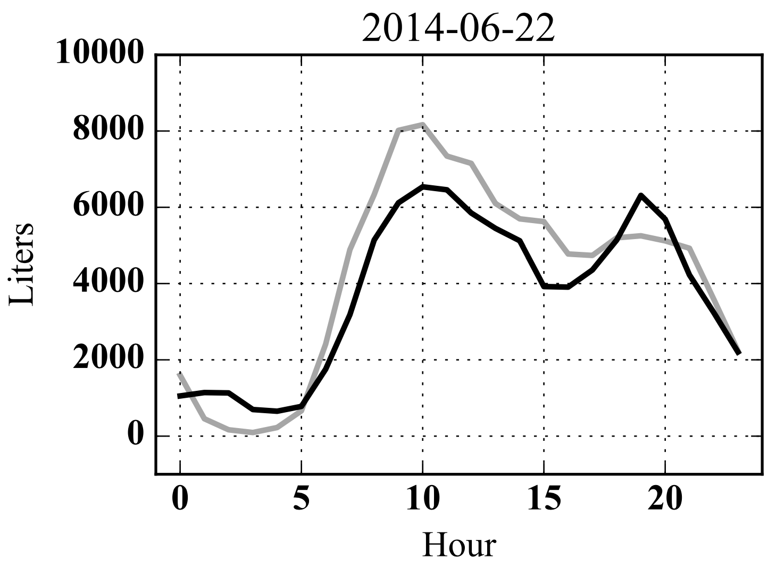
Motivation Time Series
Motivation
Hybrid Indexing
Hybrid Queries
Visual Exploration
Local Similarity
Scalable Forecasting
Conclusions
Time Series (TS)
A time-ordered sequence of values
Industry: Energy, finance, product sales, water consumption
Science: Astronomy, biology, pollution, meteorology
Mining and exploring TS data
Discover trends or patterns
Extract useful insights
Researchers mostly focus on similarity search
Speed-up using indexing

Slide 4
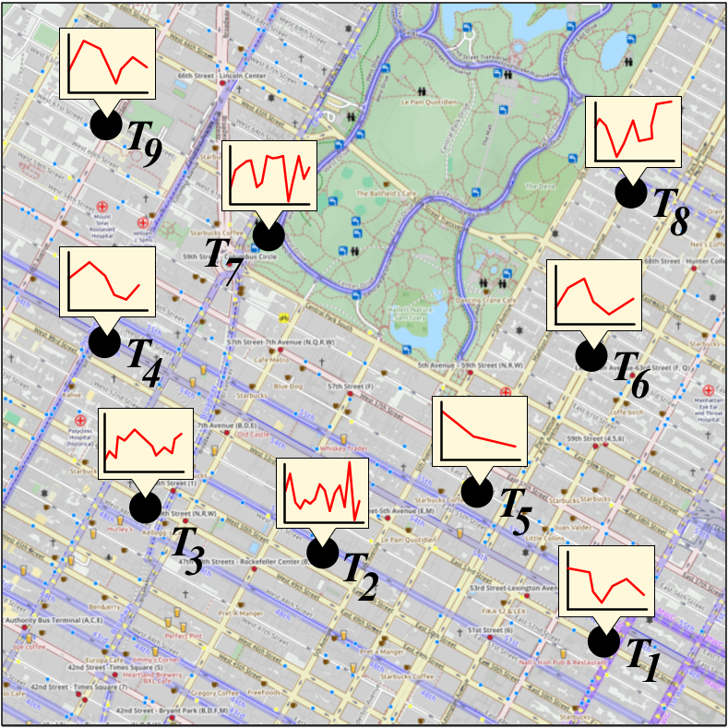
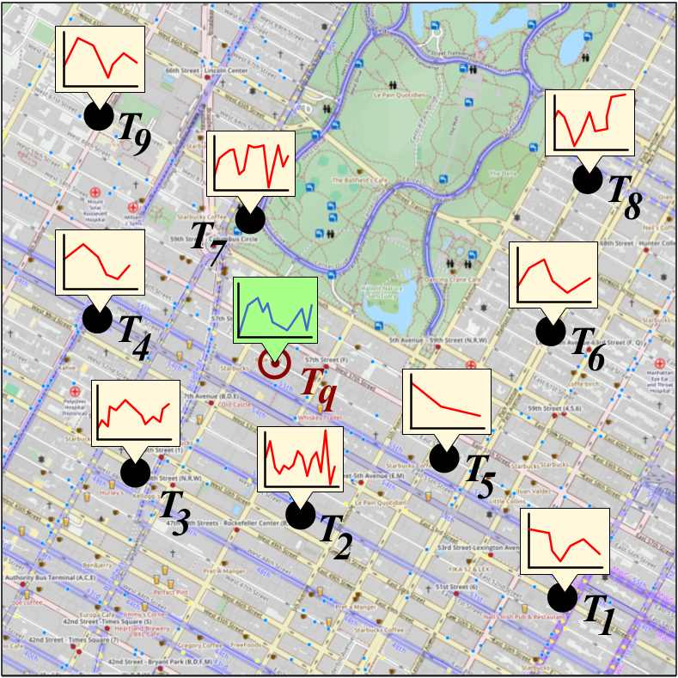
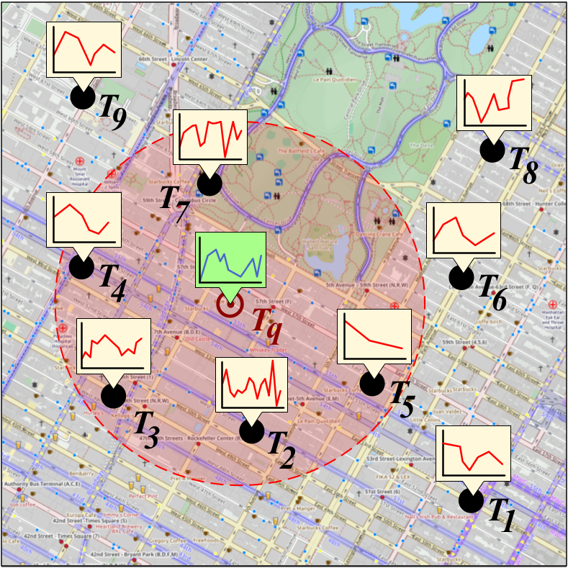
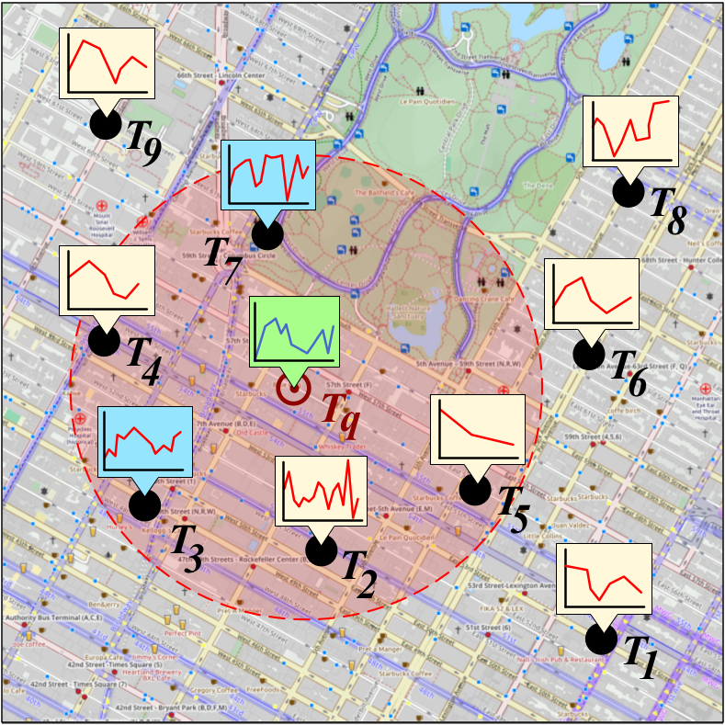
Motivation Geolocated Time Series
Motivation
Hybrid Indexing
Hybrid Queries
Visual Exploration
Local Similarity
Scalable Forecasting
Conclusions
Geolocated Time Series (geoTS)
Time series associated with specific locations
Geosocial networks, geomarketing, geotagged user posts, sensors
Indexing/mining time series and spatial data
Lack of support for geolocated time series
Allow efficient similarity search
Both on spatial proximity and time series similarity
Fast computation of hybrid queries
“Retrieve all the time series within the given range that are similar to a given time series by a pre-specified distance threshold”

Slide 5
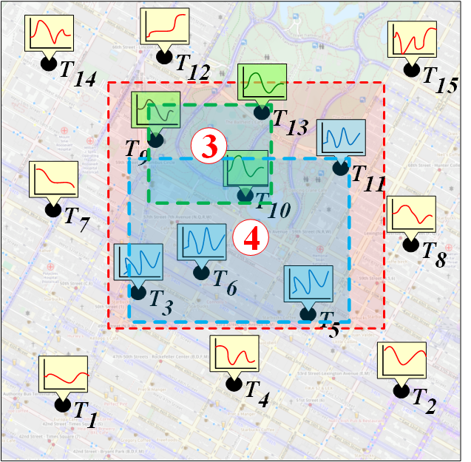
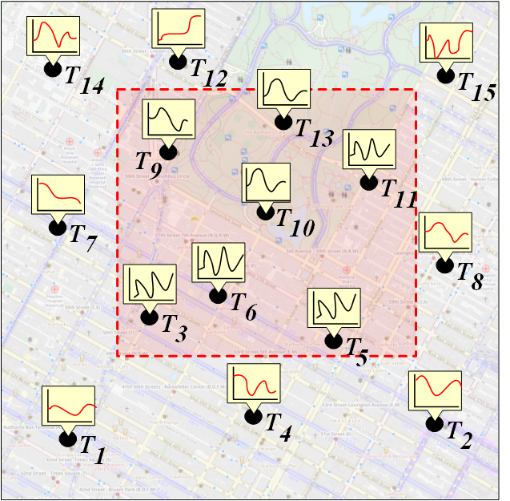
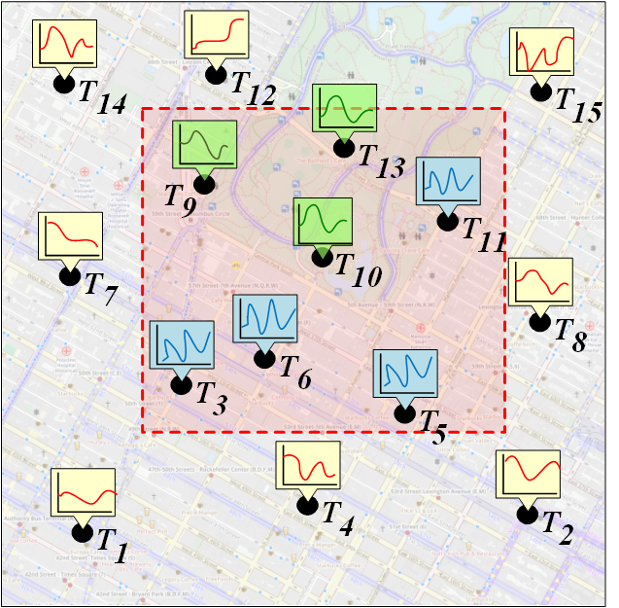
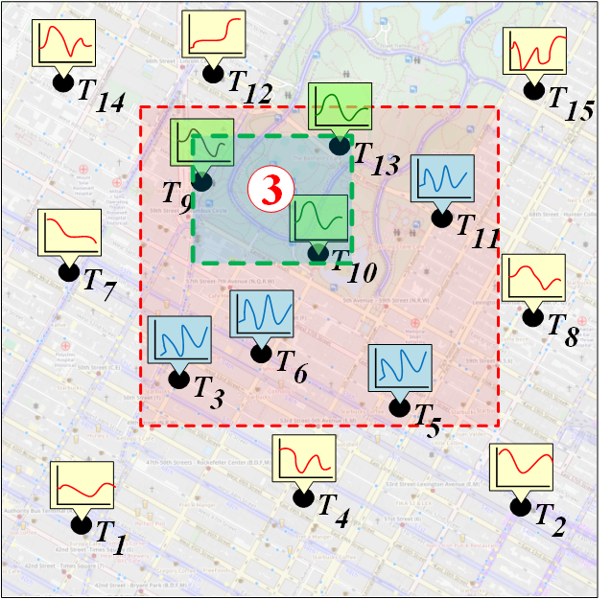
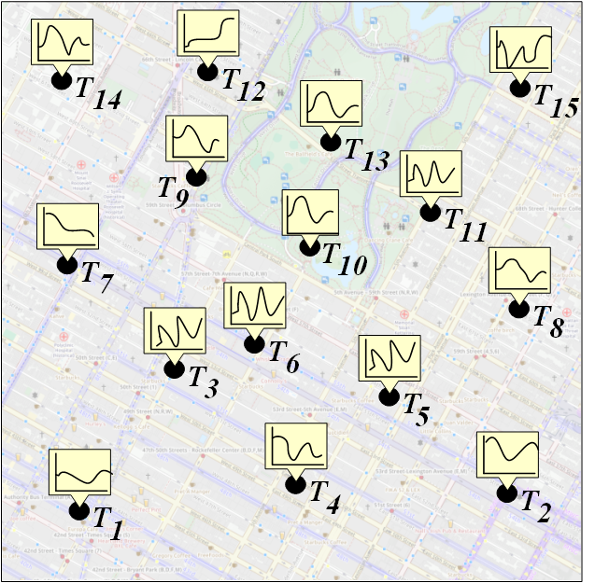
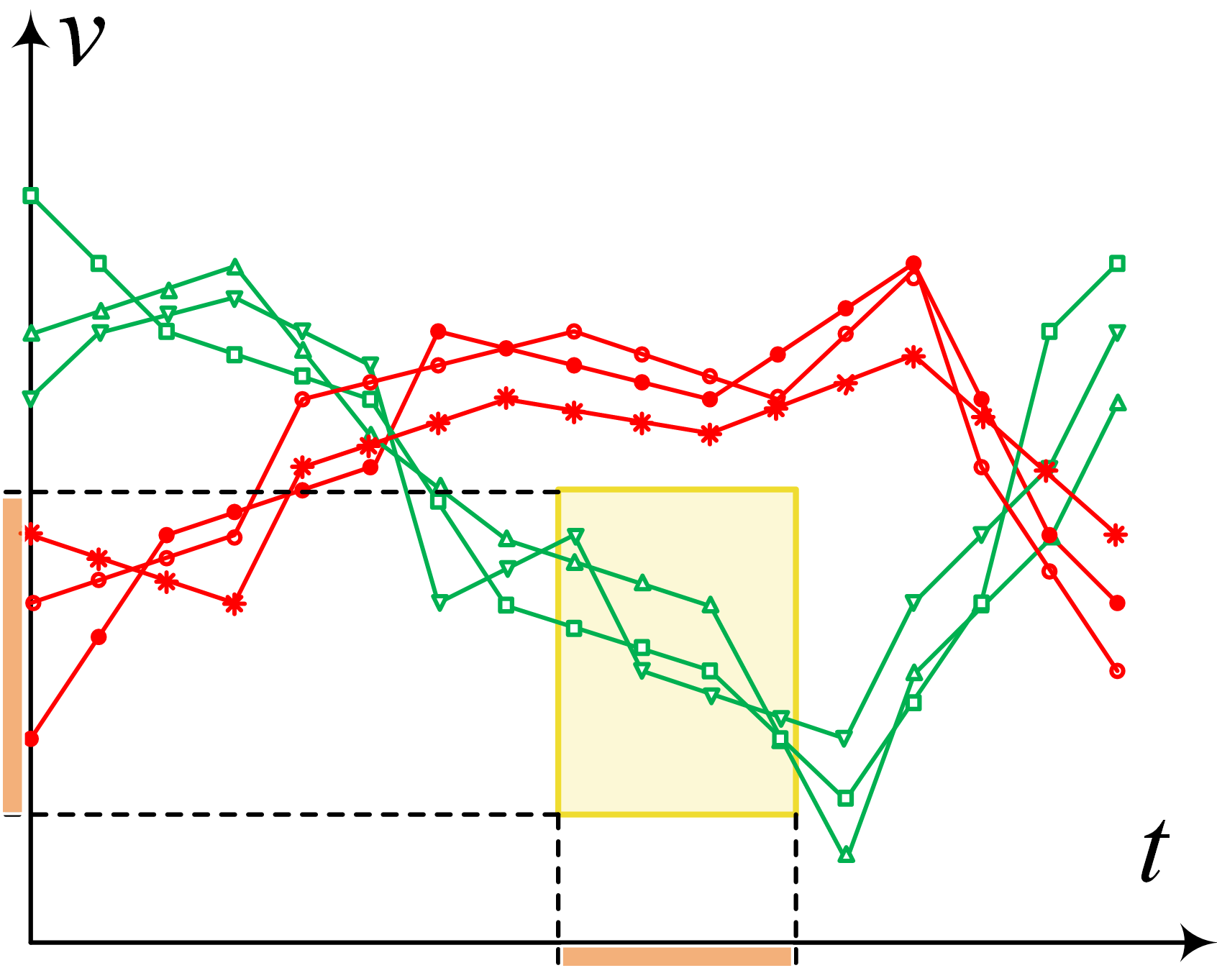
Motivation Visual Exploration of Geolocated Time Series
Motivation
Hybrid Indexing
Hybrid Queries
Visual Exploration
Local Similarity
Scalable Forecasting
Conclusions
Efficient visual exploration of very large geoTS datasets
Insightful visualizations
Should allow interactive exploration
Computationally expensive
Large datasets
Horizontally (length of time series)
Vertically (number of time series)
Need to consider both spatial distance and time series similarity
Hybrid indexing

Slide 6
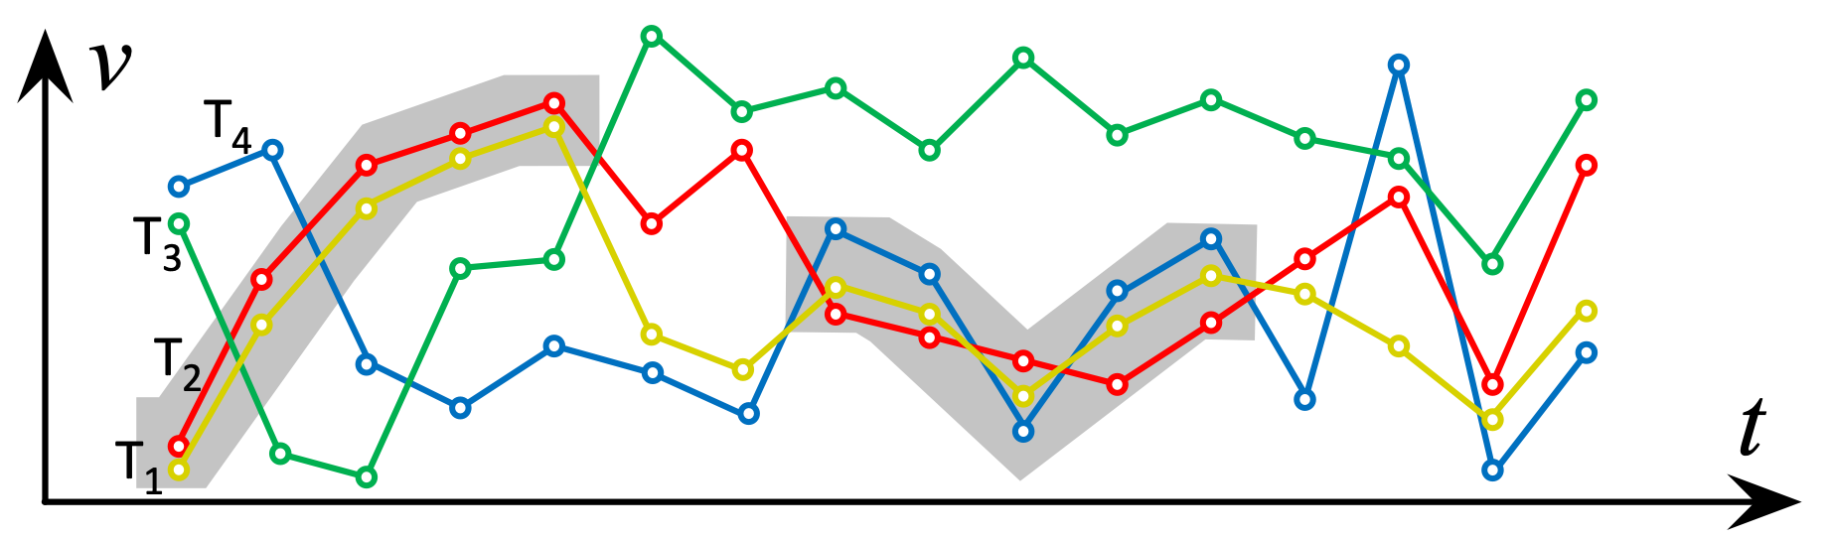
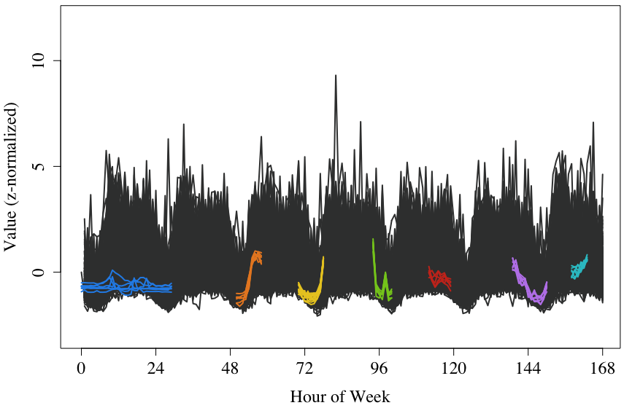
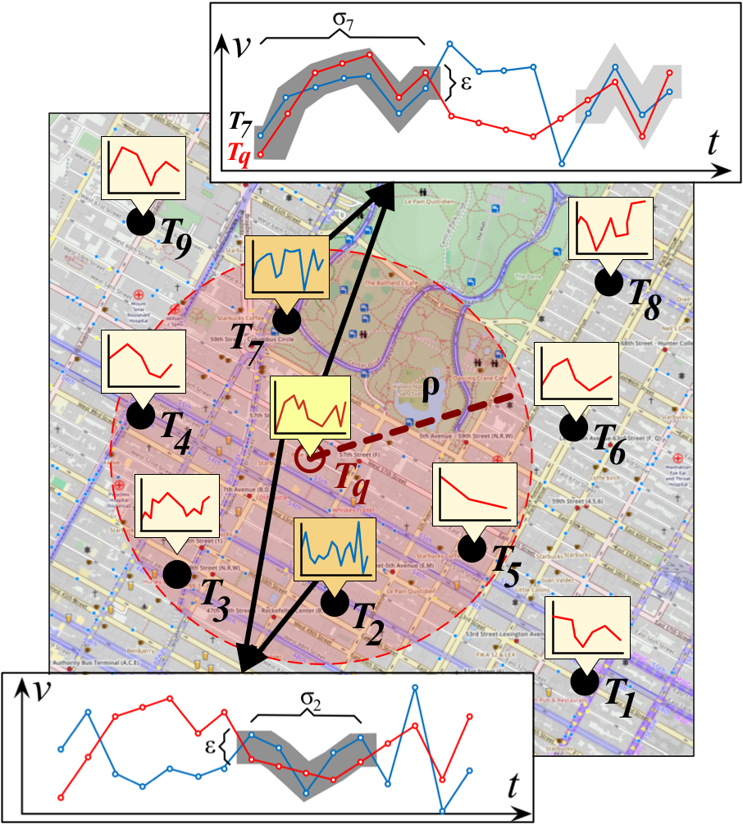
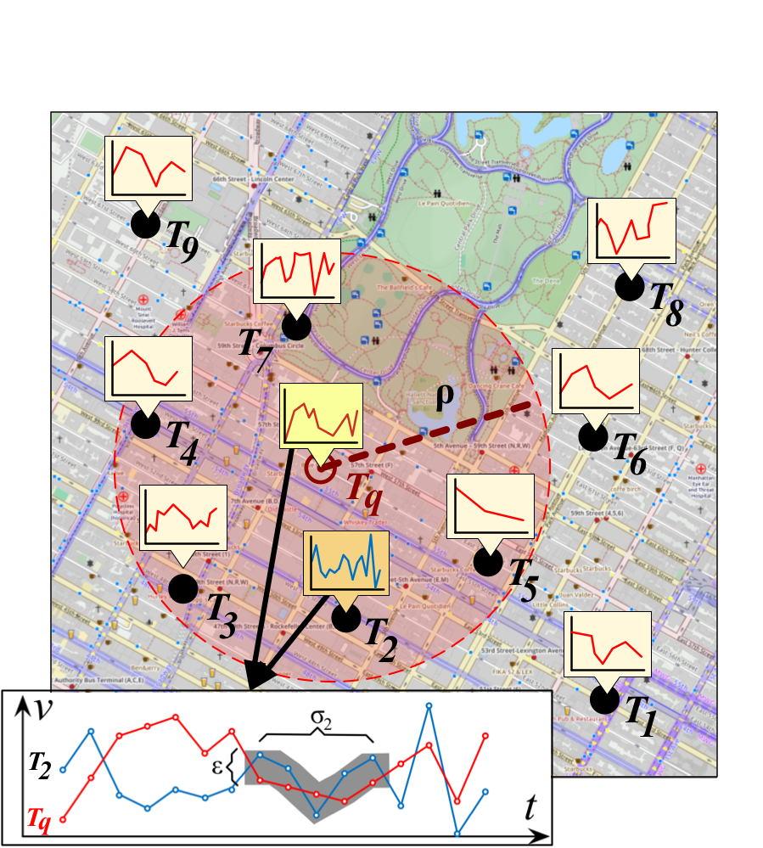
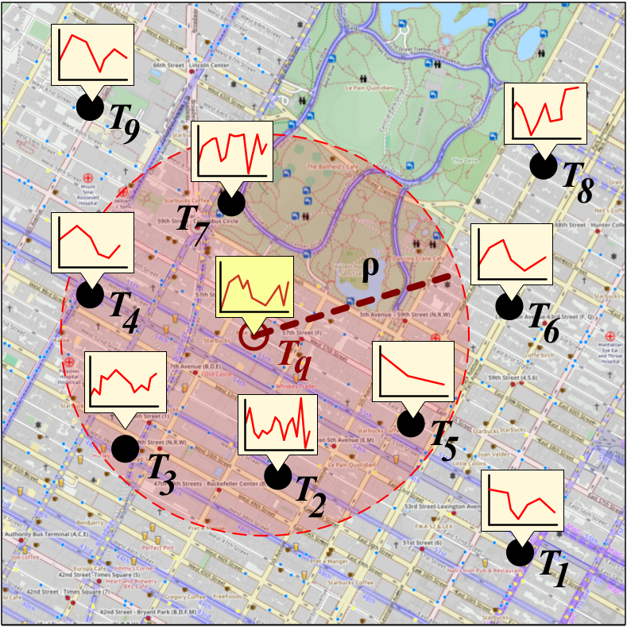

Motivation Local Similarity
Motivation
Hybrid Indexing
Hybrid Queries
Visual Exploration
Local Similarity
Scalable Forecasting
Conclusions
TS similarity search thoroughly researched
Euclidean distance, dynamic time warping
Local similarity: Similar values during one or more intervals
Discover pairs or bundles (groups) of locally similar subsequences
Reveal similar patterns
Identify similar trends
Computationally expensive
Hybrid local similarity search on geoTS
Both on spatial proximity and time series local similarity
Hybrid indexing

Slide 7
Motivation Time Series Forecasting
Motivation
Hybrid Indexing
Hybrid Queries
Visual Exploration
Local Similarity
Scalable Forecasting
Conclusions
Predict future values of TS
Resource demand management, stock market, supply demand
TS forecasting can be performed by regression
Linear regression, Auto Regressive Integrated Moving Average (ARIMA), k-Nearest Neighbors (kNN)
Big Data
Apply forecasting simultaneously on many TS
E.g., household resource consumption of an entire city
Computationally expensive
Distributed and parallel processing
MapReduce paradigm
Apache Flink is more flexible

Slide 8
Hybrid Indexing Outline
Motivation
Hybrid Indexing
Hybrid Queries
Visual Exploration
Local Similarity
Scalable Forecasting
Conclusions
We propose a hybrid index
Efficiently support similarity search on geoTS
Combine spatial proximity and time series similarity
TSR-Tree
Extension of R-Tree
Each node augmented with time series bounds
Same logic as R-Tree’s MBRs
BTSR-Tree
Optimized variant of TSR-Tree
Similar time series are bundled
Tighter bounds → Less dead space → More efficient pruning

Slide 9
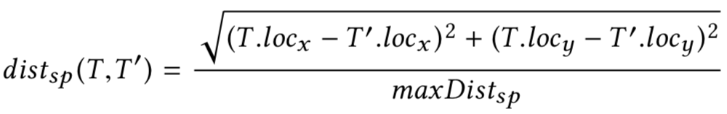
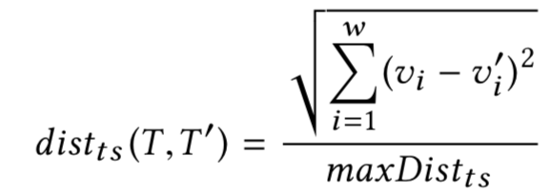
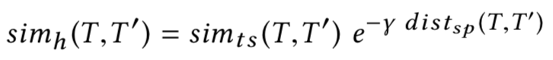
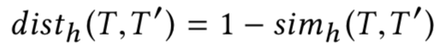
Preliminaries
Motivation
Hybrid Indexing
Hybrid Queries
Visual Exploration
Local Similarity
Scalable Forecasting
Conclusions
Spatial distance
Time series distance
Hybrid distance

Slide 10
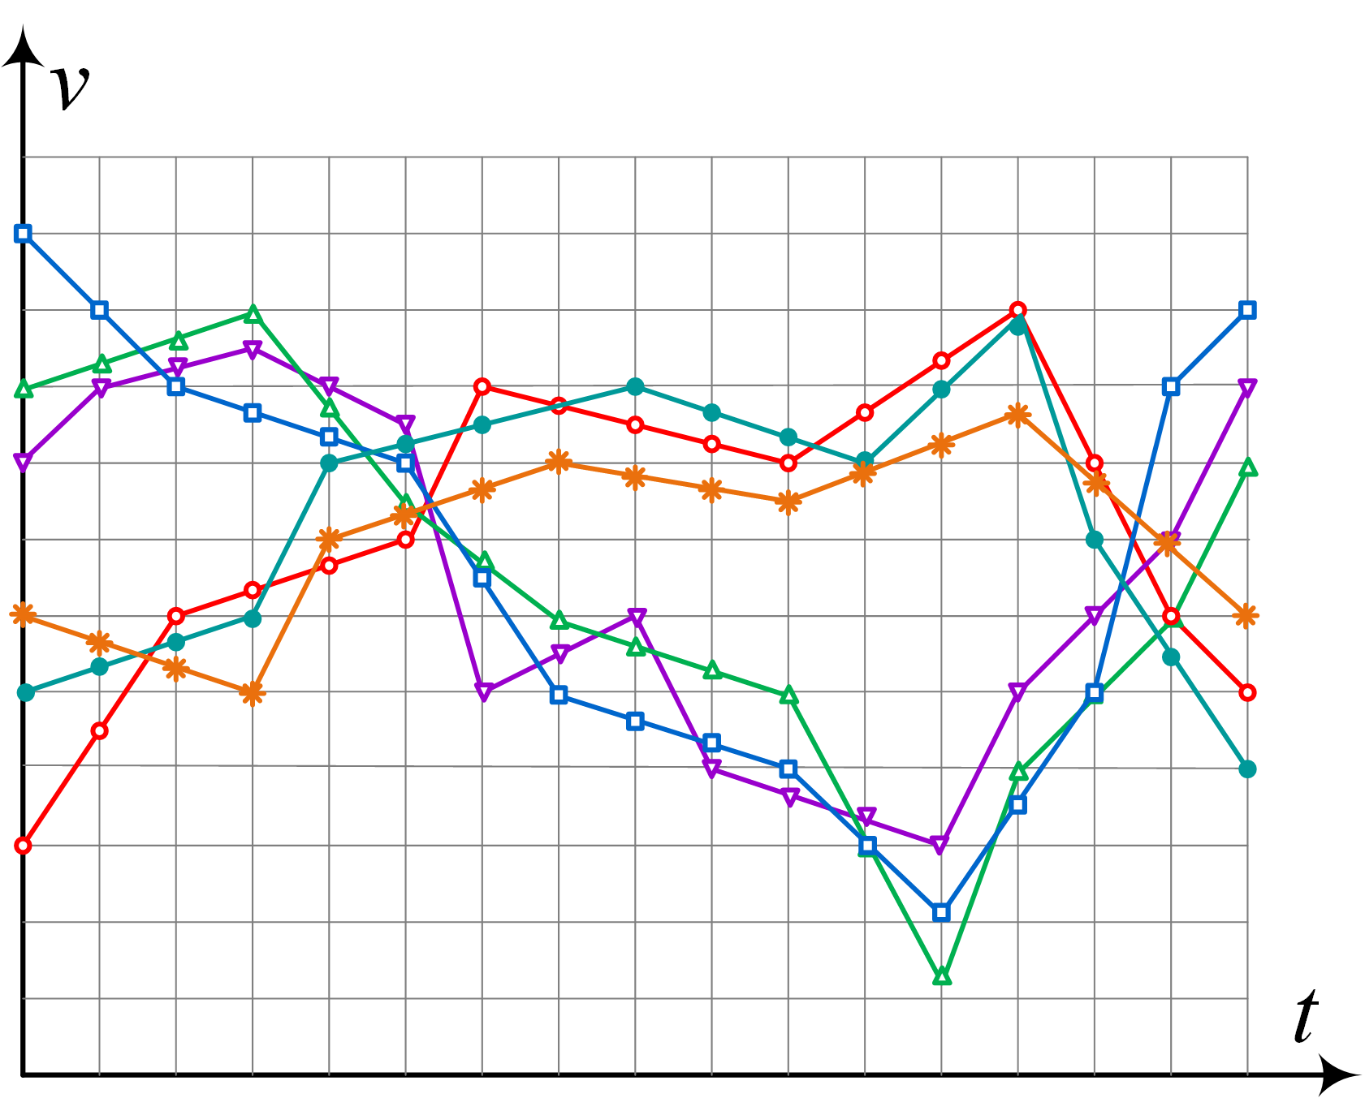
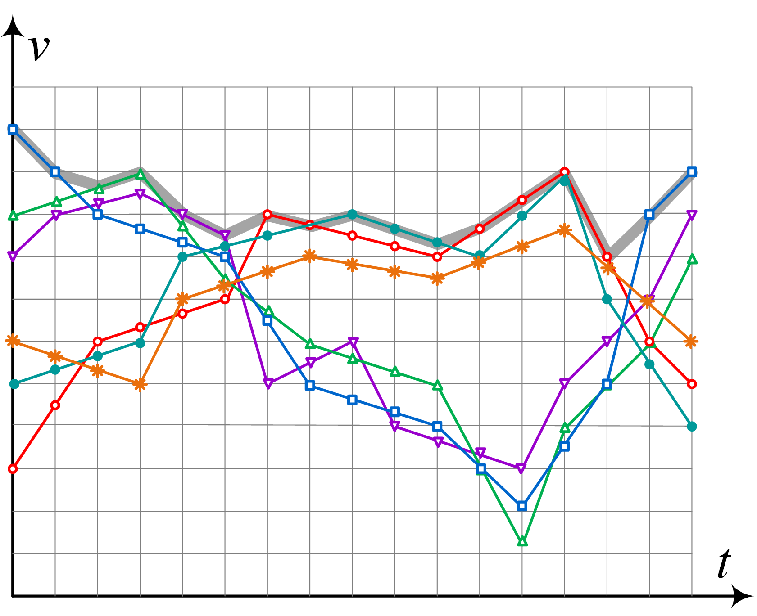
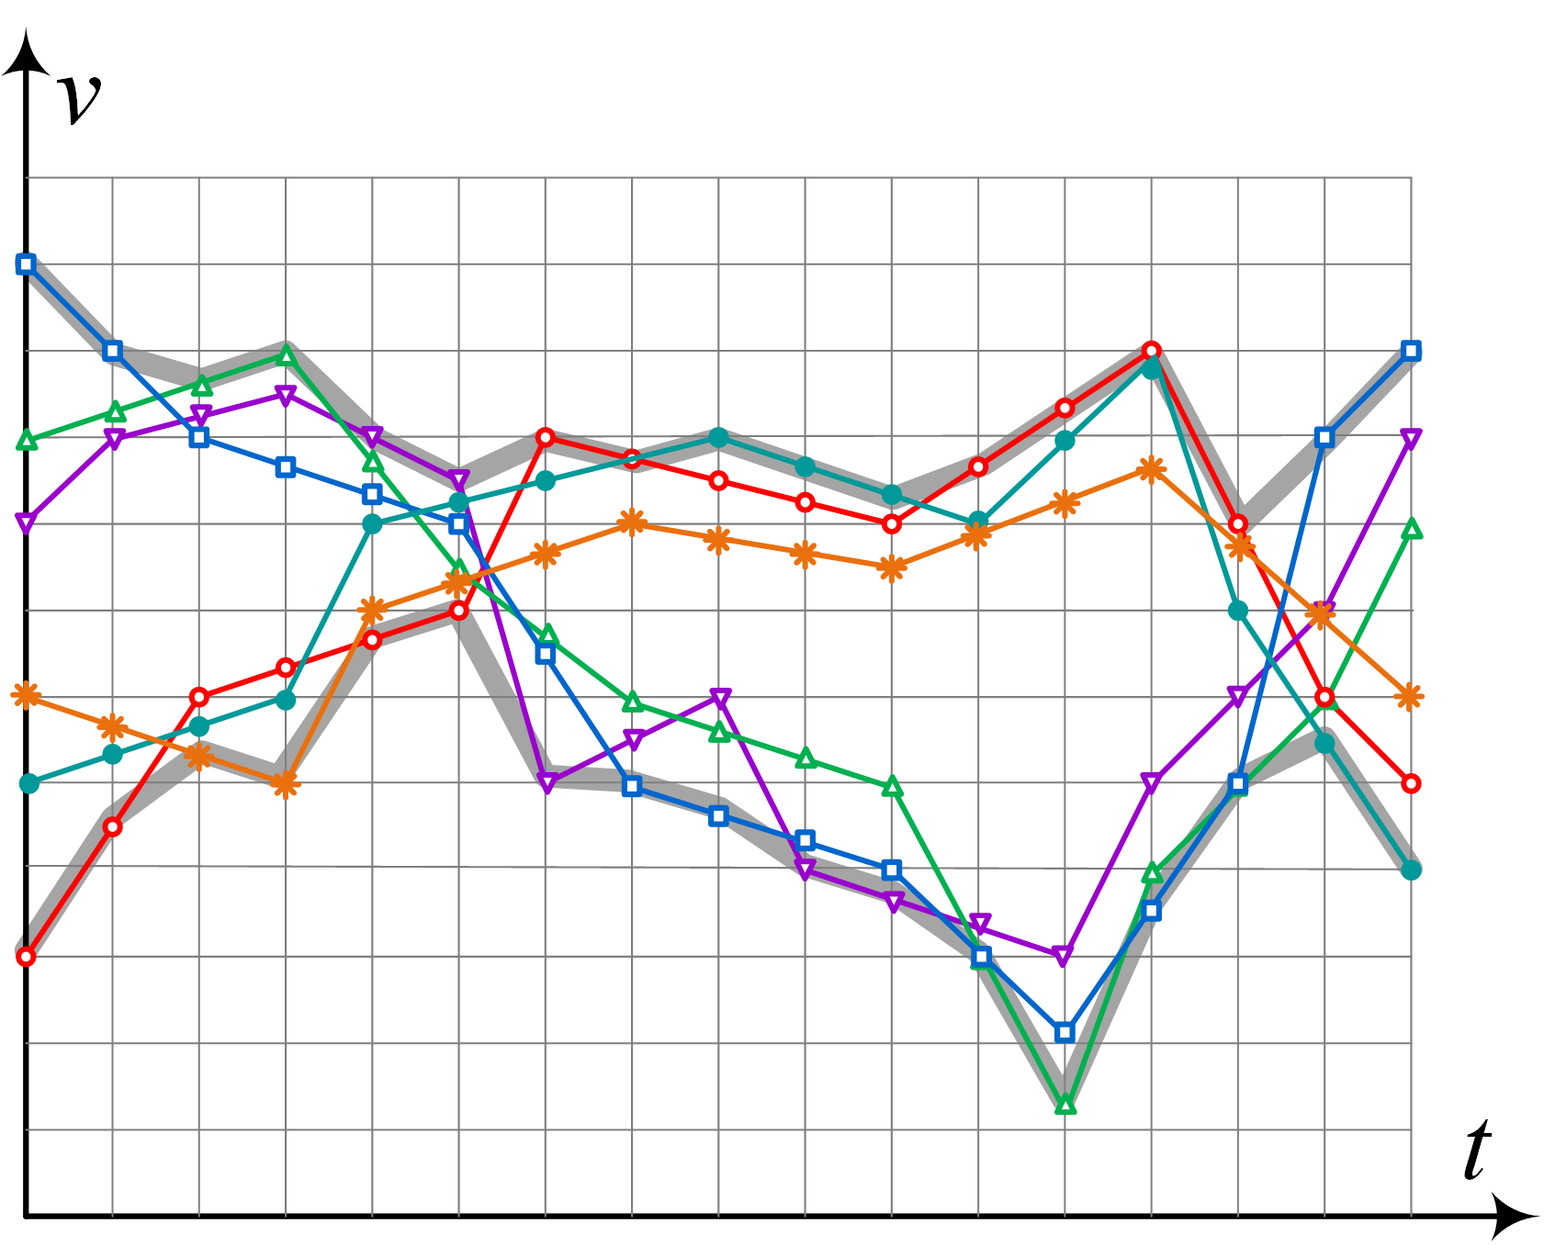
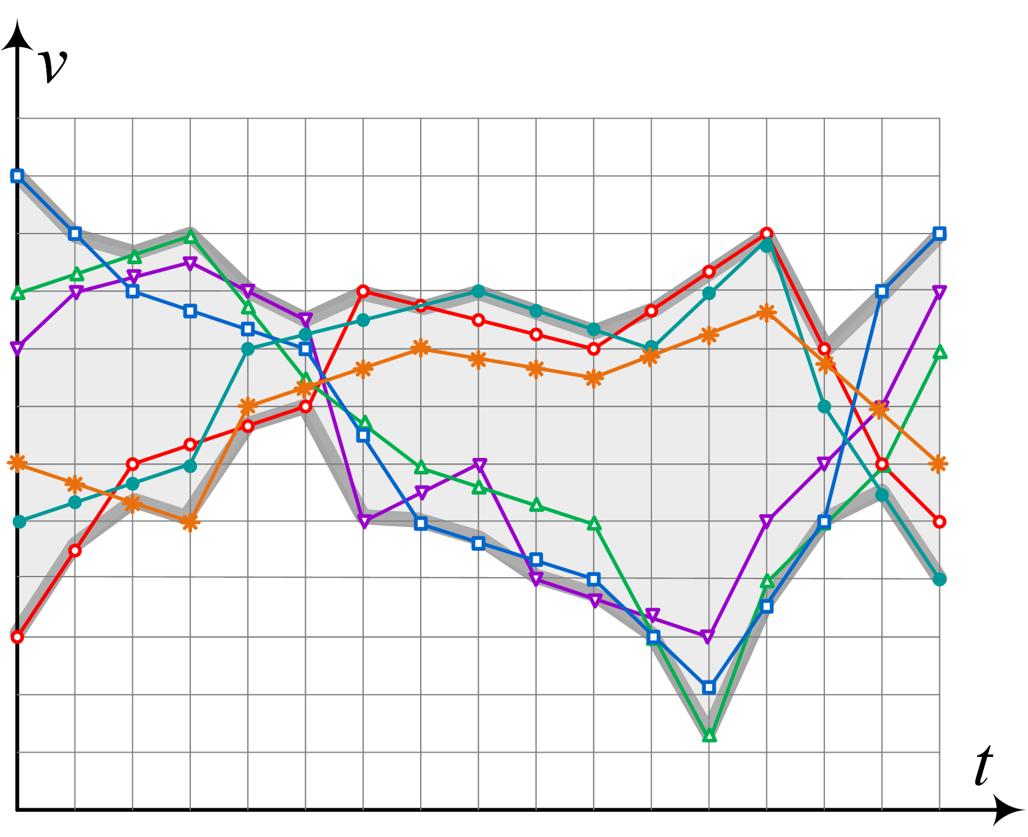
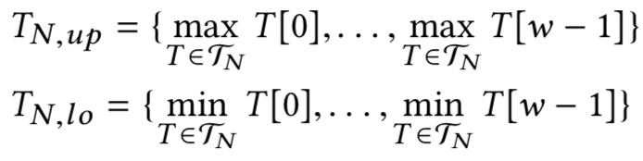
The TSR-Tree Index Structure
Motivation
Hybrid Indexing
Hybrid Queries
Visual Exploration
Local Similarity
Scalable Forecasting
Conclusions
Spatial-first
Enhanced R-Tree → each node:
At least m and at most M entries
MBRs of its children
Minimum Bounding Time Series (MBTS) for each child
Upon insertion select node accordingly

Slide 11
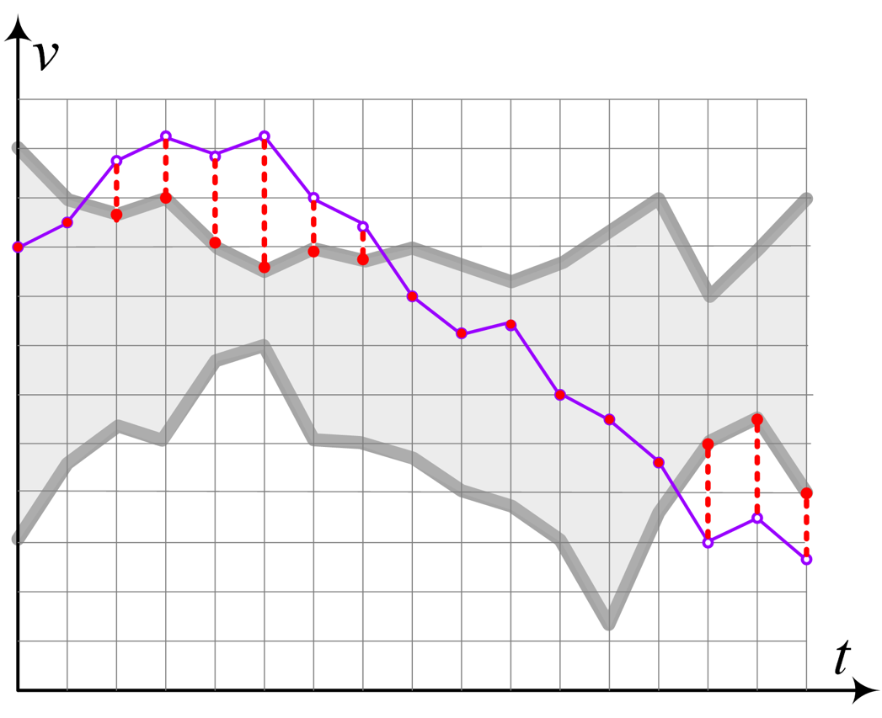
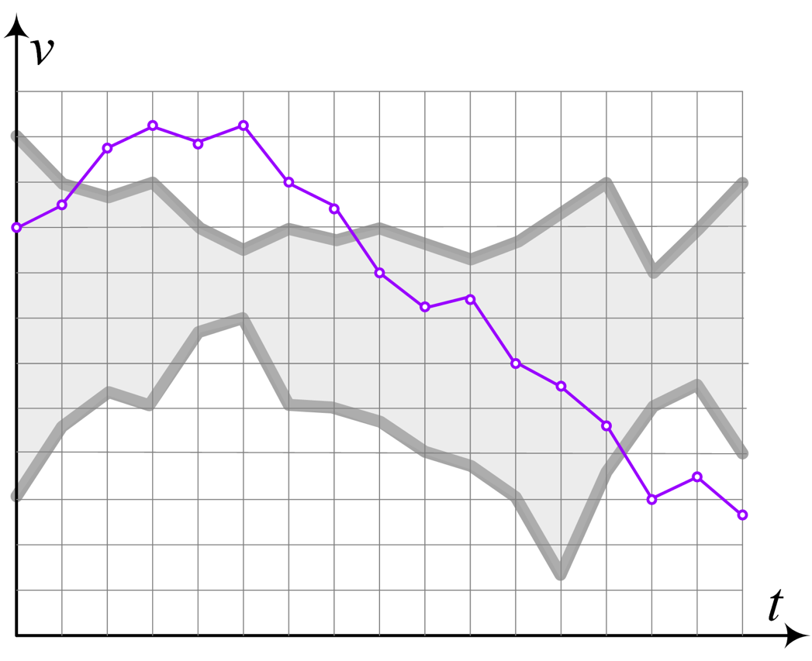
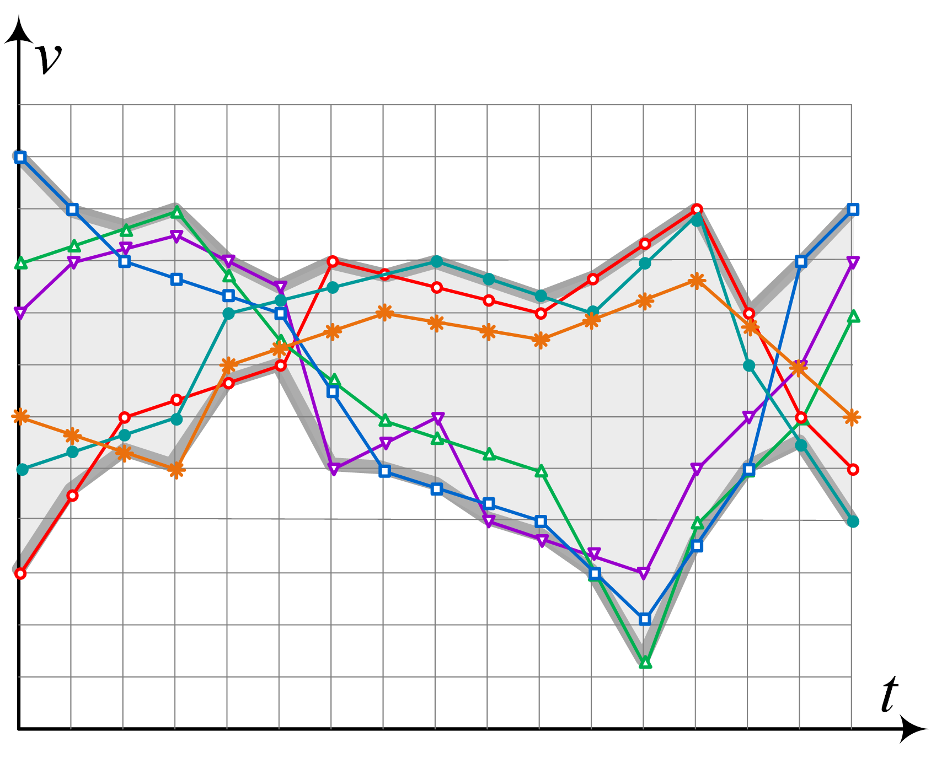
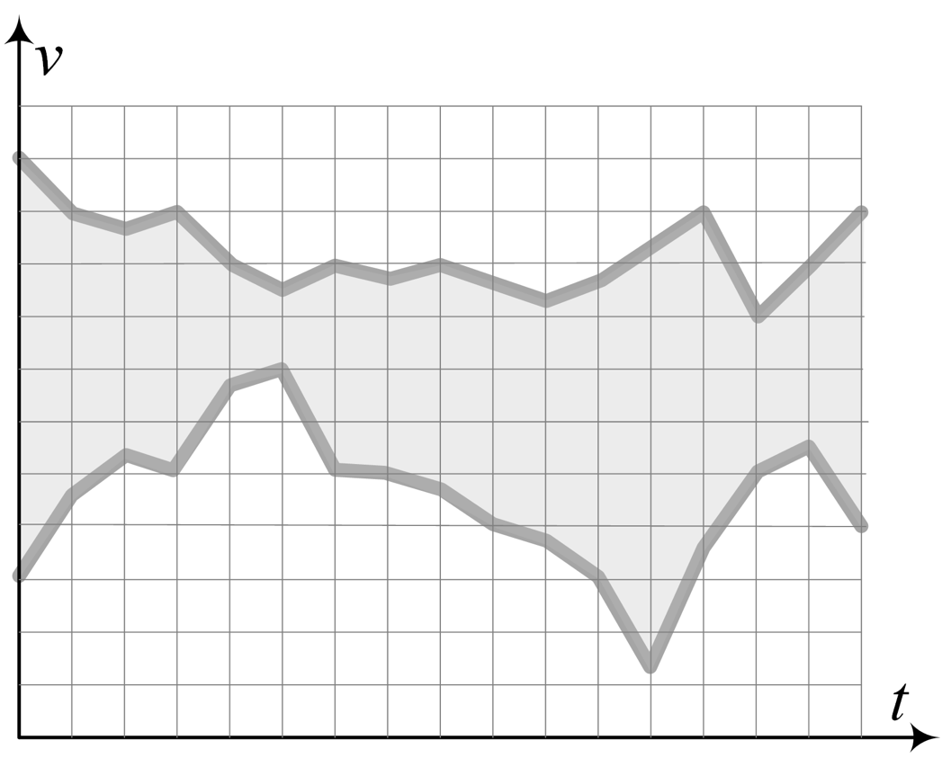
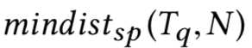
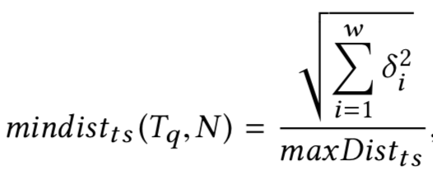
The TSR-Tree Index Node Pruning
Motivation
Hybrid Indexing
Hybrid Queries
Visual Exploration
Local Similarity
Scalable Forecasting
Conclusions
Prune subtrees that do cannot contain any results
Lower bounding
Spatial domain
similarly to R-Tree
Time series domain
Hybrid

Slide 12

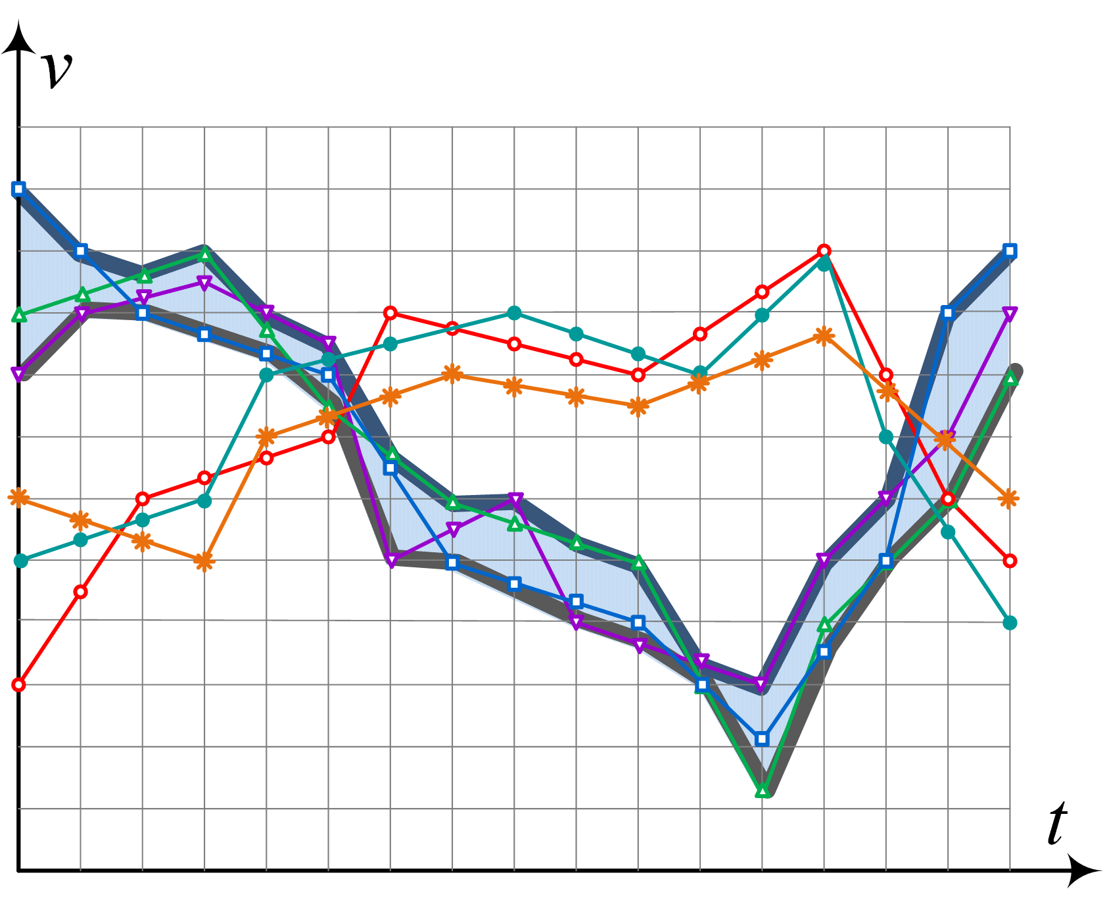
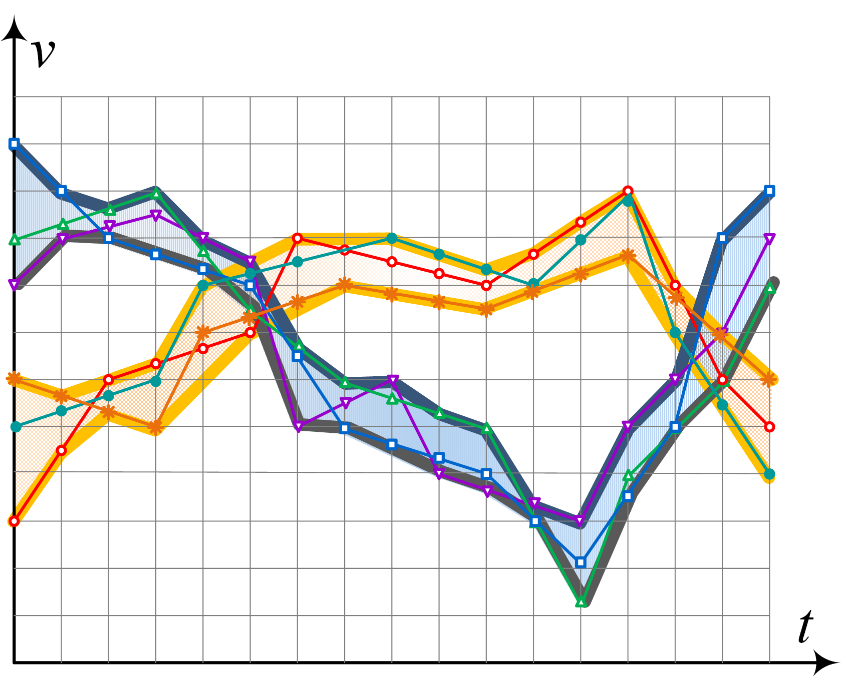
The BTSR-Tree Index
Motivation
Hybrid Indexing
Hybrid Queries
Visual Exploration
Local Similarity
Scalable Forecasting
Conclusions
TSR-Tree → no guarantee that time series in a node are highly similar
Increased dead space
Solution: bundle similar time series together and construct individual MBTS
k-means clustering
Tighter bounds
Eliminate even more dead space
Increase number of bundles bottom-up
Maintain node capacity by decreasing the resolution of the MBTS bottom-up
Piecewise Aggregate Approximation (PAA)

Slide 13
Experimental Evaluation Construction Time and Size
Motivation
Hybrid Indexing
Hybrid Queries
Visual Exploration
Local Similarity
Scalable Forecasting
Conclusions

Slide 14
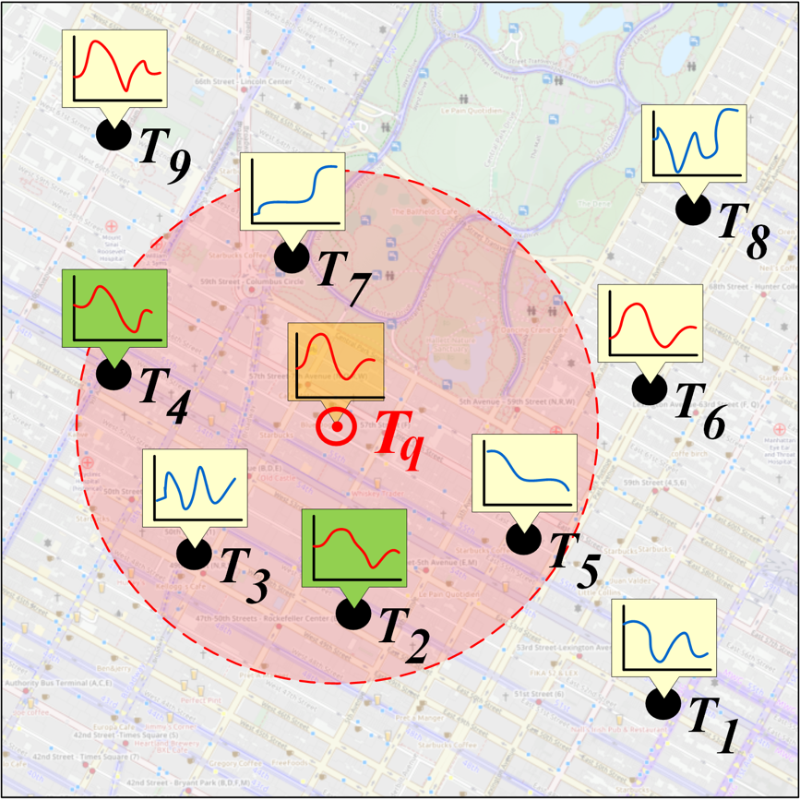
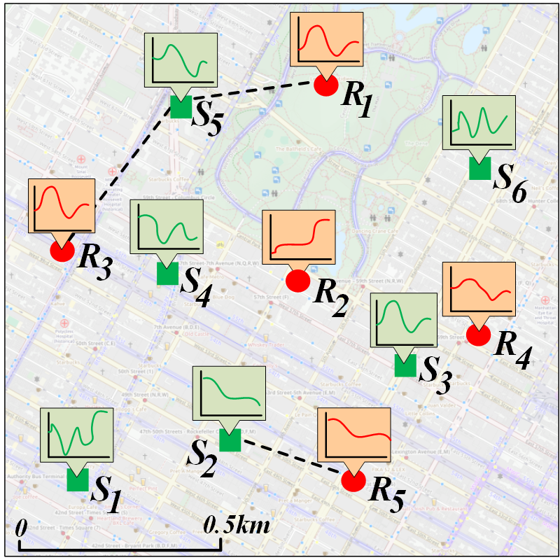
Hybrid Queries Outline
Motivation
Hybrid Indexing
Hybrid Queries
Visual Exploration
Local Similarity
Scalable Forecasting
Conclusions
Employ hybrid indexing
Hybrid Similarity Search (HSS)
Five hybrid query variants
Three filtering approaches
Spatial-only (R-Tree), hybrid (TSR-Tree, BTSR-Tree)
Hybrid Similarity Join (HSJ)
Three filtering approaches
Spatial-only (R-Tree), TS-only (iSAX), hybrid (BTSR-Tree)
Centralized and distributed implementations
Space-driven data partitioning
Similarity join within each partition
Optimization that minimizes communication

Slide 15
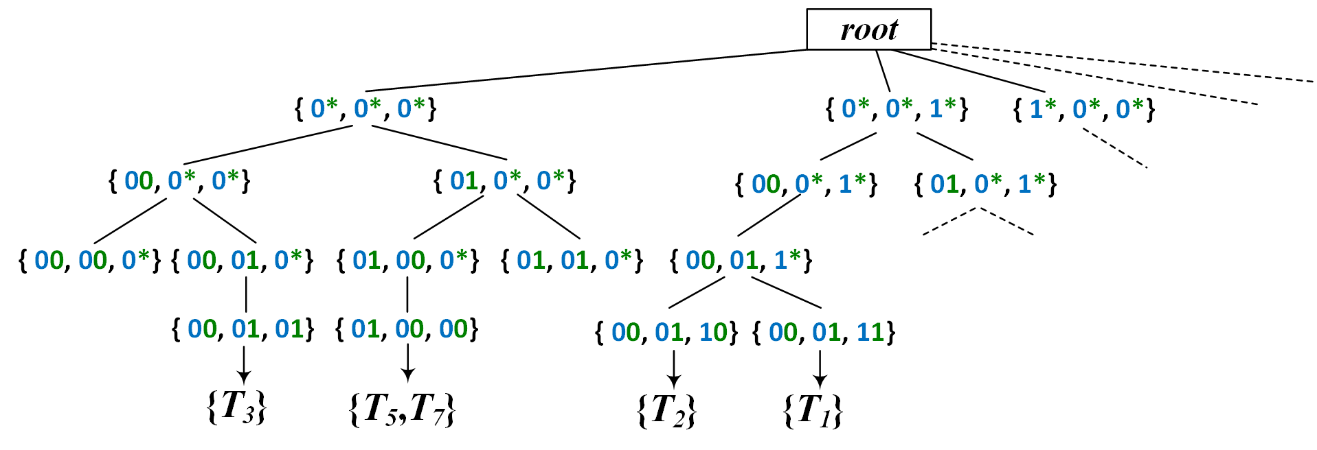
Preliminaries iSAX Index
Motivation
Hybrid Indexing
Hybrid Queries
Visual Exploration
Local Similarity
Scalable Forecasting
Conclusions
Indexable SAX
Leaf nodes point to files with raw data
Inner nodes split SAX space
Split dimension chosen via round robin
Binary split
Fully contain subtrees’ SAX space union

Slide 16
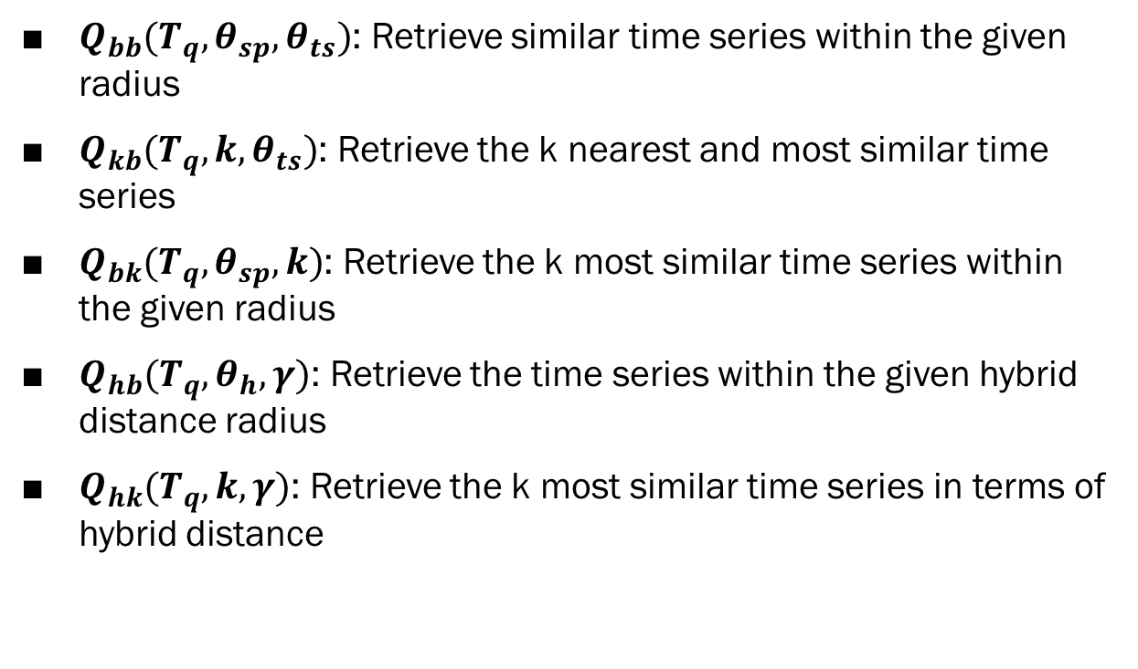
HSS Query Variants
Motivation
Hybrid Indexing
Hybrid Queries
Visual Exploration
Local Similarity
Scalable Forecasting
Conclusions
$Q_{bb}(T_{q},θ_{sp},θ_{ts})$: Retrieve similar time series within the given radius
$Q_{kb}(T_{q}, k, θ_{ts})$: Retrieve the k nearest and most similar time series
$Q_{bk}(T_{q}, θ_{sp}, k)$: Retrieve the k most similar time series within the given radius
$Q_{hb}(T_{q}, θ_{h}, γ)$: Retrieve the time series within the given hybrid distance radius
$Q_{hk}(T_{q}, k, γ)$: Retrieve the k most similar time series in terms of hybrid distance

Slide 17
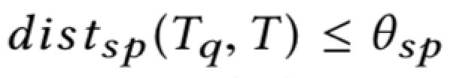
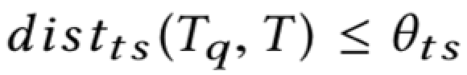
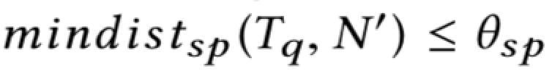
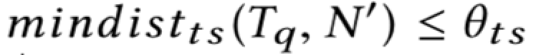

Processing HSS Queries $Q_{bb}$ Query
Motivation
Hybrid Indexing
Hybrid Queries
Visual Exploration
Local Similarity
Scalable Forecasting
Conclusions
Initially read the children nodes of the root in a list
Loop over the generated list
If a child is a leaf, loop over its elements
For each element check if:
and
If true, add the element to the result set
If a child is an inner node, loop over its child nodes
For each child node check if:
and
If true, add the children of the nodes to the list and repeat
Finally, return the result set

Slide 18

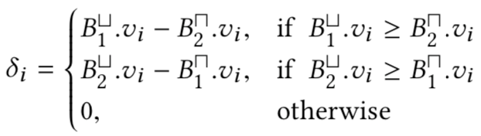
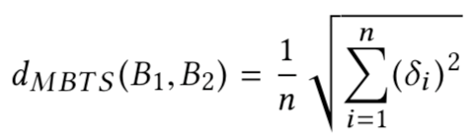
Centralized HSJ
Motivation
Hybrid Indexing
Hybrid Queries
Visual Exploration
Local Similarity
Scalable Forecasting
Conclusions
Spatial-Only
Two geoTS datasets
Build an R-Tree per dataset
Time Series-Only
Two iSAX indices
Hybrid
Two BTSR-Tree indices
Deviation MBTS

Slide 19
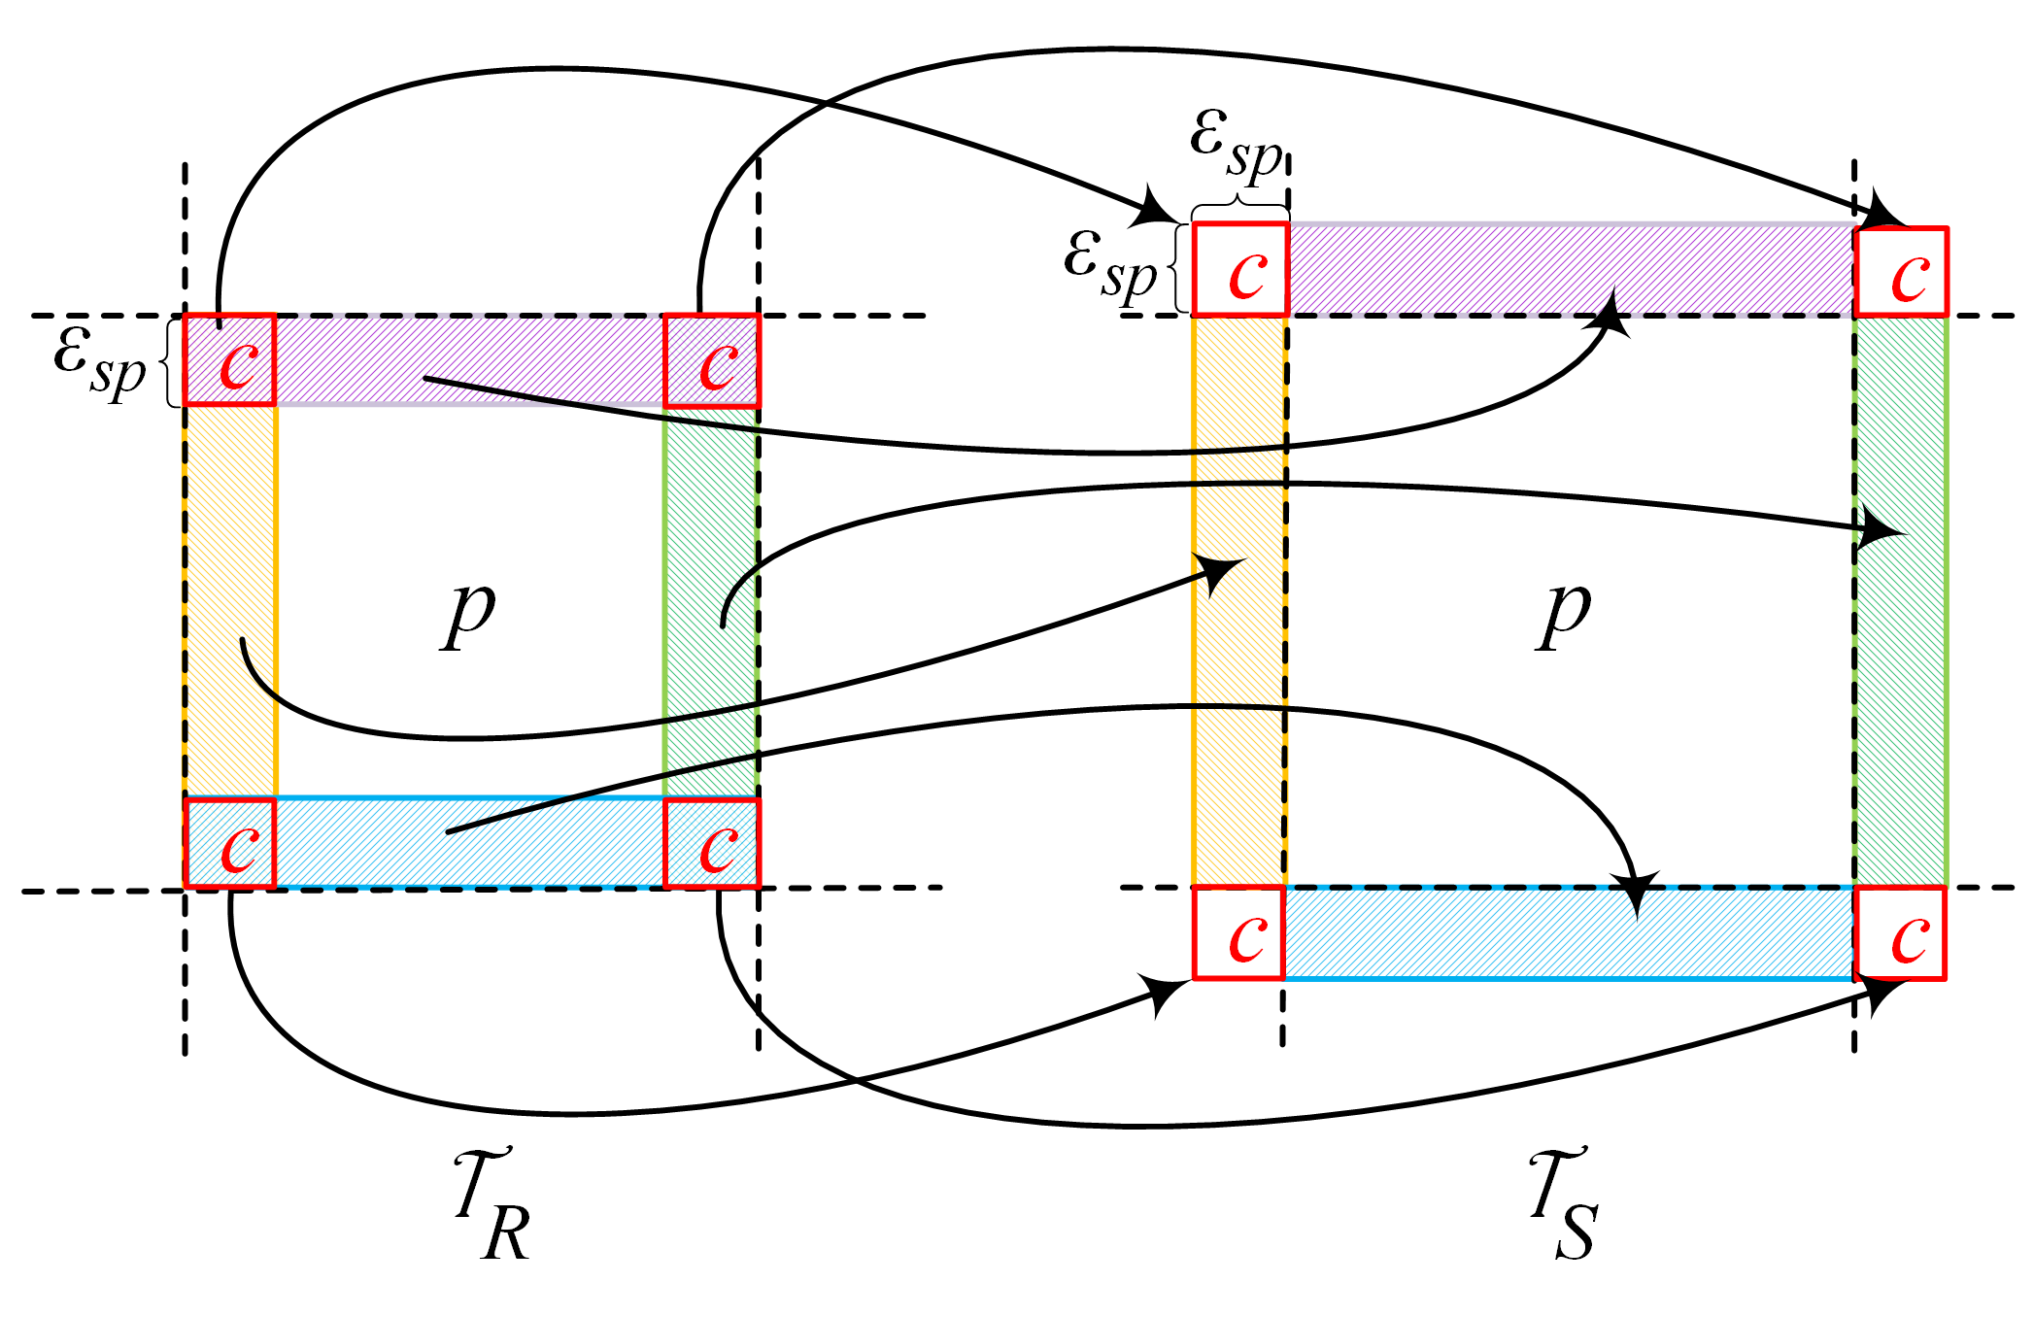
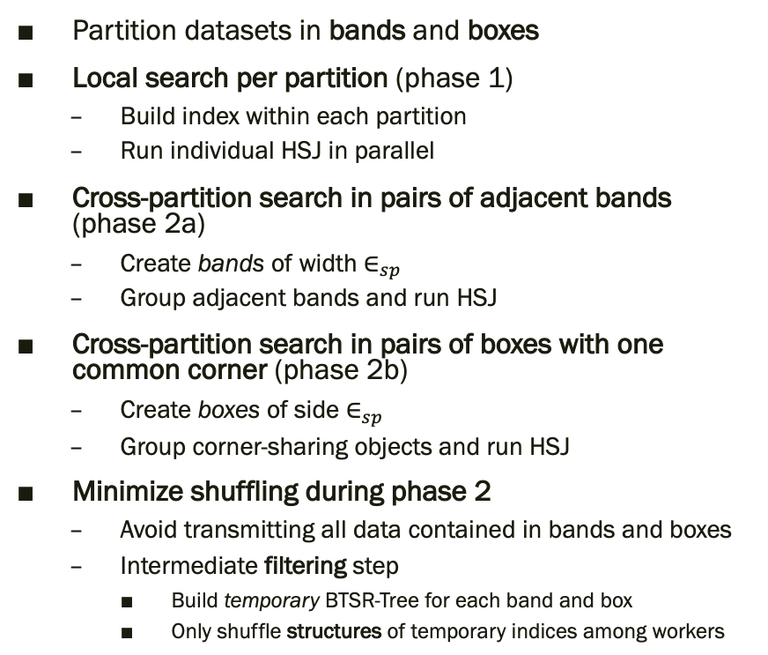
Distributed HSJ Process
Motivation
Hybrid Indexing
Hybrid Queries
Visual Exploration
Local Similarity
Scalable Forecasting
Conclusions
Partition datasets in bands and boxes
Local search per partition (phase 1)
Build index within each partition
Run individual HSJ in parallel
Cross-partition search in pairs of adjacent bands (phase 2a)
Create bands of width $∈_{sp}$
Group adjacent bands and run HSJ
Cross-partition search in pairs of boxes with one common corner (phase 2b)
Create boxes of side $∈_{sp}$
Group corner-sharing objects and run HSJ
Minimize shuffling during phase 2
Avoid transmitting all data contained in bands and boxes
Intermediate filtering step
Build temporary BTSR-Tree for each band and box
Only shuffle structures of temporary indices among workers

Slide 20
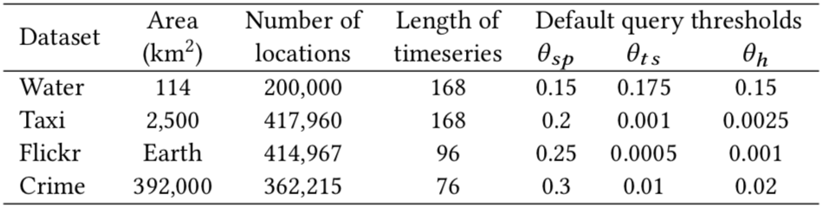
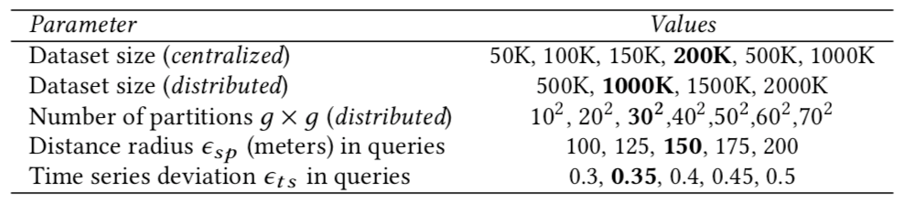
Experimental Evaluation Setup
Motivation
Hybrid Indexing
Hybrid Queries
Visual Exploration
Local Similarity
Scalable Forecasting
Conclusions
Real world and synthetic datasets from various application domains
Up to 2 million geoTS
Comparison across various index and query parameters

Slide 21
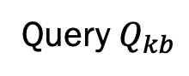
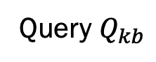
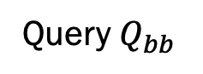





Experimental Evaluation Hybrid Similarity Search
Motivation
Hybrid Indexing
Hybrid Queries
Visual Exploration
Local Similarity
Scalable Forecasting
Conclusions
Query $Q_{kb}$
Query $Q_{bb}$
Query $Q_{bk}$
Query $Q_{hb}$
Query $Q_{kb}$
Query $Q_{bk}$
Query $Q_{bk}$
Query $Q_{hk}$

Slide 22
Experimental Evaluation Hybrid Similarity Join
Motivation
Hybrid Indexing
Hybrid Queries
Visual Exploration
Local Similarity
Scalable Forecasting
Conclusions

Slide 23


Visual Exploration of Geolocated Time Series Outline
Motivation
Hybrid Indexing
Hybrid Queries
Visual Exploration
Local Similarity
Scalable Forecasting
Conclusions
Big time series data
Apply hybrid indexing for efficiency
Two summarization methods that share the same spatial summary – sets of MBRs
Enable interactive visual exploration for geoTS
Bundle Summary
Exploit the BTSR-Tree index
Retrieve summaries of geoTS within a given area
Tile Map Summary
New hybrid index geo-iSAX
Enable timebox search on geoTS datasets

Slide 24
Bundle Summary Process
Motivation
Hybrid Indexing
Hybrid Queries
Visual Exploration
Local Similarity
Scalable Forecasting
Conclusions
Used to generate our map-based visualization
Called whenever the user zooms in/out or moves the map
Takes the current visible area as input
Quickly obtains time series and spatial summaries
Comprises three steps:
Step 1: BTSR-Tree Traversal
Step 2: Bundles Clustering
Step 3: Bundles Calculation and MBR Assignment

Slide 25


Tile Map Summary geo-iSAX Index
Motivation
Hybrid Indexing
Hybrid Queries
Visual Exploration
Local Similarity
Scalable Forecasting
Conclusions
Time series-first hybrid index
Each node contains
SAX word describing children nodes
MBR of children nodes
MBRs tend to highly overlap
Avoid by introducing alternative splitting policy
iSAX splits using round robin
Instead split on the dimension that will produce the smallest overlapping area

Slide 26




Tile Map Summary Process
Motivation
Hybrid Indexing
Hybrid Queries
Visual Exploration
Local Similarity
Scalable Forecasting
Conclusions
Traverse geo-iSAX given current visible area and a user-drawn timebox
At each node first check if visible area overlaps MBR
If so, check if node’s SAX rectangle overlaps timebox
If it does, traverse current node
Otherwise, safely prune

Slide 27


Experimental Evaluation Setup
Motivation
Hybrid Indexing
Hybrid Queries
Visual Exploration
Local Similarity
Scalable Forecasting
Conclusions
Two real world datasets from different application domains
One synthetic dataset

Slide 28
Experimental Evaluation Map Visualization (Bundle Summary)
Motivation
Hybrid Indexing
Hybrid Queries
Visual Exploration
Local Similarity
Scalable Forecasting
Conclusions
Map Scale 1:5000

Slide 29
Experimental Evaluation Map Visualization (Tile Map Summary)
Motivation
Hybrid Indexing
Hybrid Queries
Visual Exploration
Local Similarity
Scalable Forecasting
Conclusions
Map Scale 1:10000

Slide 30
Experimental Evaluation Performance Results (Bundle Summary)
Motivation
Hybrid Indexing
Hybrid Queries
Visual Exploration
Local Similarity
Scalable Forecasting
Conclusions

Slide 31
Experimental Evaluation Performance Results (Tile Map Summary)
Motivation
Hybrid Indexing
Hybrid Queries
Visual Exploration
Local Similarity
Scalable Forecasting
Conclusions

Slide 32


Local Similarity Search Outline
Motivation
Hybrid Indexing
Hybrid Queries
Visual Exploration
Local Similarity
Scalable Forecasting
Conclusions
Local pair and bundle discovery
Co-evolving time series: Time-aligned
Discover all possible pairs and bundles
Employ filter-verification and discretize value axis
Sweep-line scan
Checkpoint approach
Examine for candidates at specific time stamps
Local similarity search on geoTS
Three hybrid local similarity-based queries (LS-Queries)
Answer using BTSR-Tree index
SBTSR-Tree index
Optimized version of BTSR-Tree
Partition time domain in segments
Handle cross-segment continuity
Tighter bounds → Less dead space → More efficient pruning

Slide 33


Pair/Bundle Discovery Value Discretization
Motivation
Hybrid Indexing
Hybrid Queries
Visual Exploration
Local Similarity
Scalable Forecasting
Conclusions
Reduce candidate checks per timestamp
Discretize value axis
Bins of size $ε$
Same bin time series form pairs
Also check adjacent bins
Consider value range of size $ε$
Upper endpoint coincides with value at time $t$
All values within range form candidate pairs
At each timestamp:
Filtering: Search within adjacent bins
Verification: For each candidate, check successive timestamps

Slide 34

















Pair/Bundle Discovery Checkpoints
Motivation
Hybrid Indexing
Hybrid Queries
Visual Exploration
Local Similarity
Scalable Forecasting
Conclusions
Placed every $δ$ timestamps
No false negatives
Assume $δ=4$ and a qualifying pair at an intermediate timestamp
Starting at $t^{′}−δ+1$
If smaller duration it would not meet $δ$
Ending at $t^{′}+δ−1$
Similarly
Default checkpoint placement might yield increased number of candidates
Too many verifications
More scattered values at a timestamp
Less candidates
Solution: Collectively shift the checkpoints to less dense areas

Slide 35







LS-Queries Using the BTSR-Tree Bounding Distance
Motivation
Hybrid Indexing
Hybrid Queries
Visual Exploration
Local Similarity
Scalable Forecasting
Conclusions
Prune search space
Spatial proximity and time series local similarity
Spatial filtering as in standard R-Tree
Time series filtering using mindist
Local similarity score bound $σ_{Β}$
Maximum interval of consecutive timestamps where mindist $≤ε$
Safely prune nodes for which $σ_{B}$ less than a given threshold $δ$
All the above apply using checkpoints

Slide 36




The SBTSR-Tree Index Index Structure
Motivation
Hybrid Indexing
Hybrid Queries
Visual Exploration
Local Similarity
Scalable Forecasting
Conclusions
Clustering time series in BTSR-Tree nodes might generate dead space
Negative impact on pruning
SBTSR-Tree
Reduce amount of overlap by segmenting time series
Tighter MBTS per node
More pruning potential
MBTS in neighboring segments might enclose different sets of time series
Lost continuity
Need to check every neighboring MBTS
Solution: Use bit-vectors
When 1, neighboring MBTS have common time series
Further optimize filtering

Slide 37

Experimental Evaluation Pair/Bundle Discovery (Setup)
Motivation
Hybrid Indexing
Hybrid Queries
Visual Exploration
Local Similarity
Scalable Forecasting
Conclusions
A real world and a synthetic dataset
Water: Courtesy of the DAIAD project
Alicante, Spain
822 households
Weekly average time series per household (168 hours)
Synthetic: Sinusoids of different aptitudes and frequencies
A total of 50,000,000 data points

Slide 38








Experimental Evaluation Pair/Bundle Discovery
Motivation
Hybrid Indexing
Hybrid Queries
Visual Exploration
Local Similarity
Scalable Forecasting
Conclusions

Slide 39

Experimental Evaluation Local Similarity Search on geoTS (Setup)
Motivation
Hybrid Indexing
Hybrid Queries
Visual Exploration
Local Similarity
Scalable Forecasting
Conclusions
Three real-world datasets
BTSR-Tree SL Vs BTSR-Tree CP Vs SBTSR-Tree CP
Comparison across various query parameters
Execution time
Scalability evaluation

Slide 40








Experimental Evaluation Local Similarity Search on geoTS ($Q_{rr}$)
Motivation
Hybrid Indexing
Hybrid Queries
Visual Exploration
Local Similarity
Scalable Forecasting
Conclusions
Crime
Flickr
Taxi

Slide 41






Experimental Evaluation Scalability
Motivation
Hybrid Indexing
Hybrid Queries
Visual Exploration
Local Similarity
Scalable Forecasting
Conclusions
$$Q_{rr}$$
$$Q_{kr}$$
$$Q_{rk}$$

Slide 42
Scalable Time Series Forecasting Outline
Motivation
Hybrid Indexing
Hybrid Queries
Visual Exploration
Local Similarity
Scalable Forecasting
Conclusions
FML-kNN framework for scalable data analytics
Based on kNN Join
Probabilistic classification
Regression
Suitable for time series forecasting and other analytics tasks
Probabilistic classification via a weighted voting scheme
Each NN is weighted according to its distance to the query
Based on state-of-the-art H-zkNN algorithm
Apache Hadoop
Three separate distributed processing session
Implemented with the more flexible Apache Flink
In just a single distributed processing session
Apache Spark implementation for evaluation

Slide 43

Preliminaries Space-Filling Curves
Motivation
Hybrid Indexing
Hybrid Queries
Visual Exploration
Local Similarity
Scalable Forecasting
Conclusions
We support three popular Space Filling Curves (SFC)
z-order curve
Gray-code curve
Hilbert curve

Slide 44


The FML-kNN Framework Workflow
Motivation
Hybrid Indexing
Hybrid Queries
Visual Exploration
Local Similarity
Scalable Forecasting
Conclusions
Data pre-processing (stage 1)
Shift the dataset if requested
Apply dimensionality reduction via SFC
Calculate and broadcast partitioning ranges to stage 2
Forward dataset to stage 2
Data partitioning and organization (stage 2)
Forward each partition to the proper reducer
Local kNN computation
kNN computation (stage 3)
Collect and calculate final kNNs for each element
Perform probabilistic classification or regression
Requires just a single distributed session

Slide 45
Experimental Evaluation
Motivation
Hybrid Indexing
Hybrid Queries
Visual Exploration
Local Similarity
Scalable Forecasting
Conclusions

Slide 46
Conclusions and Future Work (I/III)
Motivation
Hybrid Indexing
Hybrid Queries
Visual Exploration
Local Similarity
Scalable Forecasting
Conclusions
Problem: scalable indexing and exploration of big time series data
Geolocated time series (geoTS)
BTSR-Tree index
Hybrid similarity search queries
Hybrid Similarity Join
Visual exploration of geoTS
Bundle summary
Tile map summary
geo-iSAX index
Local similarity search
Pair/Bundle discovery using checkpoints
Hybrid local similarity queries (LS-Queries) on geoTS
SBTSR-Tree index

Slide 47
Conclusions and Future Work (II/III)
Motivation
Hybrid Indexing
Hybrid Queries
Visual Exploration
Local Similarity
Scalable Forecasting
Conclusions
Scalable time series forecasting
Distributed FML-kNN framework
Runs in a single session
Future directions
Multi-dimensional BTSR-Tree
More detailed/fine-grained visual analytics
Support Dynamic Time Warping (DTW)
Improve scalability of pair/bundle discovery
Experiment with FML-kNN on more data sources
Add more ML functionality to FML-kNN
Explore applicability of FML-kNN on data streams

Slide 48
Conclusions and Future Work (III/III) Publications
Motivation
Hybrid Indexing
Hybrid Queries
Visual Exploration
Local Similarity
Scalable Forecasting
Conclusions
Chatzigeorgakidis, G., Karagiorgou, S., Athanasiou, S., & Skiadopoulos, S. A MapReduce based k-NN joins probabilistic classifier. In 2015 IEEE International Conference on Big Data (Big Data), 2015
Chatzigeorgakidis, G., Skoutas, D., Patroumpas, K., Athanasiou, S., & Skiadopoulos, S. Indexing geolocated time series data. In Proceedings of the 25th ACM SIGSPATIAL International Conference on Advances in Geographic Information Systems, 2017
Chatzigeorgakidis, G., Patroumpas, K., Skoutas, D., Athanasiou, S., & Skiadopoulos, S. Scalable hybrid similarity join over geolocated time series. In Proceedings of the 26th ACM SIGSPATIAL International Conference on Advances in Geographic Information Systems, 2018
Chatzigeorgakidis, G., Karagiorgou, S., Athanasiou, S., & Skiadopoulos, S. FML-kNN: scalable machine learning on Big Data using k-nearest neighbor joins. Springer Journal of Big Data, 2018
Chatzigeorgakidis, G., Skoutas, D., Patroumpas, K., Athanasiou, S., & Skiadopoulos, S. Map-Based Visual Exploration of Geolocated Time Series. In EDBT/ICDT Workshops, 2018
Chatzigeorgakidis, G., Patroumpas, K., Skoutas, D., Athanasiou, S., & Skiadopoulos, S. Visual Exploration of Geolocated Time Series with Hybrid Indexing. Elsevier Big Data Research, 2019
Chatzigeorgakidis, G., Skoutas, D., Patroumpas, K., Palpanas, T., Athanasiou, S., & Skiadopoulos, S. Local Pair and Bundle Discovery over Co-Evolving Time Series. In Proceedings of the 16th International Symposium on Spatial and Temporal Databases, 2019
Chatzigeorgakidis, G., Skoutas, D., Patroumpas, K., Palpanas, T., Athanasiou, S., & Skiadopoulos, S. Local Similarity Search on Geolocated Time Series Using Hybrid Indexing. In Proceedings of the 27th ACM SIGSPATIAL International Conference on Advances in Geographic Information Systems, 2019

Slide 49
Thank you!
Questions?

Slide 50


APPENDIX: SAX
Multi-resolution representation
Piecewise Aggregate Approximation (PAA)
Quantize t-axis
Symbolic Aggregate approXimation (SAX)
Quantize v-axis
Uses breakpoints
Assumes Gaussian distribution
Equi-probable symbols
SAX distance lower bound on Euclidean distance

Slide 51

APPENDIX: Centralized HSJ Spatial-Only
Two geoTS datasets
Build an R-Tree per dataset
Concurrently traversed
Examine same level nodes
If both are inner nodes
Recursively run all combinations of their children
If their MBR’s Euclidean distance is less than $∈_{sp}$
If one of them is a leaf
Recursively run all combinations with the other node’s children
If both are leaf nodes
Obtain raw geoTS and check all combinations
If they satisfy both $∈_{ts}$ and $∈_{sp}$ add them to the result

Slide 52

APPENDIX: Centralized HSJ Time Series-Only
Two iSAX indices
Concurrently traverse each tree starting from root
Examine same level nodes
If both are inner nodes
Recursively run all combinations of their children
If their SAX distance is less than $∈_{ts}$
If one of them is a leaf
Recursively run all combinations with the other node’s children
If both are leaf nodes
Obtain raw geoTS and check all combinations
If they satisfy both $∈_{ts}$ and $∈_{sp}$ add them to the result

Slide 53

APPENDIX: Centralized HSJ Hybrid
Two BTSR-Tree indices
Deviation MBTS
Traverse each tree starting from root
If both are inner nodes
Recursively run all combinations of their children
If they satisfy $∈_{sp}$ and their deviation MBTS is less than $∈_{ts}$
If one of them is a leaf
Recursively run all combinations with the other node’s children
If both are leaf nodes
Obtain raw geoTS and check all combinations
If they satisfy both $∈_{ts}$ and $∈_{sp}$ add them to the result

Slide 54
APPENDIX: Distributed HSJ Minimize Data Shuffling
Minimize shuffling during phase 2
Avoid transmitting all data contained in bands and boxes
Intermediate filtering step
Build temporary BTSR-Tree for each band and box
Only shuffle structures of temporary indices among workers
Omit raw data
Run HSJ on temporary BTSR-Trees and obtain MBR pairs
Return MBR pairs to their initial workers
Obtain contained data from temporary BTSR-Trees
Only shuffle the reduced data during phase 2

Slide 55
APPENDIX: HSJ # Results Distributed

Slide 56
APPENDIX: Bundle Summary Computation Step 1: BTSR-Tree Index Traversal
Input: Current visible map area
Insert the children nodes of the root in a queue
Loop over the generated list
If a child is an inner node:
For each of its children nodes:
If the query rectangle fully contains its MBR:
Add its MBR and MBTS to the result tuples with the following format:
Else, if the query rectangle overlaps with its MBR:
Add its children nodes to the queue
Finally, forward the result tuples to the next step

Slide 57

APPENDIX: Bundle Summary Computation Step 2: Bundles Clustering
For each received tuple:
For each MBTS of the tuple:
Calculate the average time series
Add it to a list of tuples of the following format:
Run k-means clustering using the average time series
Finally, forward the clustered tuples to the next step

Slide 58

APPENDIX: Bundle Summary Computation Step 3: Bundles Calculation
For each received cluster of tuples:
For each tuple of the cluster:
Update its MBTS (bundle)
Update its MBRs and MBR counts
Add the MBTS and MBRs to the results tuples of the following format:
Finally, return the final resulting tuples

Slide 59

APPENDIX: Pair Discovery Sweep Line Algorithm
Input: a set of co-evolving time series, $δ$ and $ε$
Iterate over each time stamp $t$. For each one:
Obtain subset of time series within two adjacent bins
Obtain all candidate pairs w.r.t. $ε$ using value range
For each pair:
If not part of the results at $t$
Verify by expanding horizontally, right-wise
When $ε$ stops being satisfied
If $δ$ is satisfied add pair to the results

Slide 60

APPENDIX: Pair Discovery Checkpoint Algorithm
Input: a set of co-evolving time series, $δ$ and $ε$
Optimally place checkpoints per $δ$ timestamps
Iterate over each checkpoint $c$. For each one:
Obtain subset of time series within two adjacent bins
Obtain all candidate pairs w.r.t. $ε$ using value range
For each pair:
If not part of the results at $t$
Verify by expanding horizontally, first left-wise, then right-wise
When $ε$ stops being satisfied
If $δ$ is satisfied add pair to the results

Slide 61

APPENDIX: Bundle Discovery Sweep Line Algorithm
Input: a set of co-evolving time series, $δ$, $ε$, and $μ$
Iterate over each timestamp $t$. For each one:
Obtain subset of time series within two adjacent bins
Obtain all candidate bundles w.r.t. $ε$ and $μ$ using value range
For each bundle:
If not part of the results at $t$
Verify by expanding horizontally, right-wise
If bundle size is reduced check current against $μ$
If $δ$ is satisfied add bundle to the results and continue with the smaller one
When bundle size less than $μ$
If $δ$ is satisfied add bundle to the results

Slide 62

APPENDIX: Bundle Discovery Checkpoint Algorithm
Input: a set of co-evolving time series, $δ$, $ε$, and $μ$
Optimally place checkpoints per $δ$ timestamps
Iterate over each checkpoint $c$. For each one:
Obtain subset of time series within two adjacent bins
Obtain all candidate bundles w.r.t. $ε$ and $μ$ using value range
For each bundle:
If not part of the results at $t$
Verify by expanding horizontally, first left-wise, then right-wise
If bundle size is reduced check current against $μ$
If $δ$ is satisfied add bundle to the results and continue with the smaller one
When bundle size less than $μ$
If $δ$ is satisfied add bundle to the results

Slide 63


APPENDIX: LS-Queries Using the BTSR-Tree Query $Q_{rr}$
Start by calculating checkpoints
Loop over root children in a list
If current node is not a leaf, loop over its children nodes
If $mindist_{sp}≤ρ$ and $VerifyMBTS=True$
Add all children back to the list
If current node is a leaf, loop over its raw geoTS
If spatial distance to query is $≤ρ$ and local similarity score $≥δ$
Add current geoTS to results
Finally, return the results

Slide 64


APPENDIX: LS-Queries Using the BTSR-Tree Query $Q_{kr}$
Start by calculating checkpoints
Push root to a priority queue based on spatial distance
While queue is not empty
Poll first element
If it is raw geoTS
Add geoTS to results
If results’ size $≥k$, break and return results
If current element is a leaf node, loop over its children geoTS
Calculate spatial distance and push back to queue
If current element is not a leaf node
If $VerifyMBTS=True$
Calculate $mindist_{sp}$ and push back to queue

Slide 65


APPENDIX: LS-Queries Using the BTSR-Tree Query $Q_{rk}$
Start by calculating checkpoints and set $δ$ threshold to 1
Push root to a priority queue based on local similarity score
While queue is not empty
Peek first element and check whether local similarity score $≤δ$
If so, break
Poll first element
If it is a leaf, loop over its children geoTS
If both $ρ$ and $δ$ are satisfied, add it to the result priority queue
If number of results $<k$ remove last element, update $δ$ and recalculate checkpoints
If element is an inner node, loop over its children and check if $mindist_{sp}≤ρ$
If so, loop over its MBTSs and calculate maximal local similarity score
If score $≥δ$ push node to priority list
Finally, when number of results $=k$, return the result priority queue

